Slide 1
Crime Management System
Performed by:-
Chinmay Jomraj
Chaitanya Joshi
Suyog Sathe

Slide 2
Problem Statement:
Many cities in USA witness an immense rise in criminal activities over the years.
Citizens of the city have to put up with crimes like robbery, assault, burglary, murder etc. on a day to day basis.

Slide 3
Purpose:
The criminal activities are increasing day by day in many parts of the country.
The purpose of this project is to curb down or possibly eliminate the criminal activities by predicting human behavior and activities in order to serve a crime free city.

Slide 4
Use Cases:
There are three main use cases in the project:
Suicide Awareness
Prevention of Sexual Assaults
Drug Free Country

Slide 5
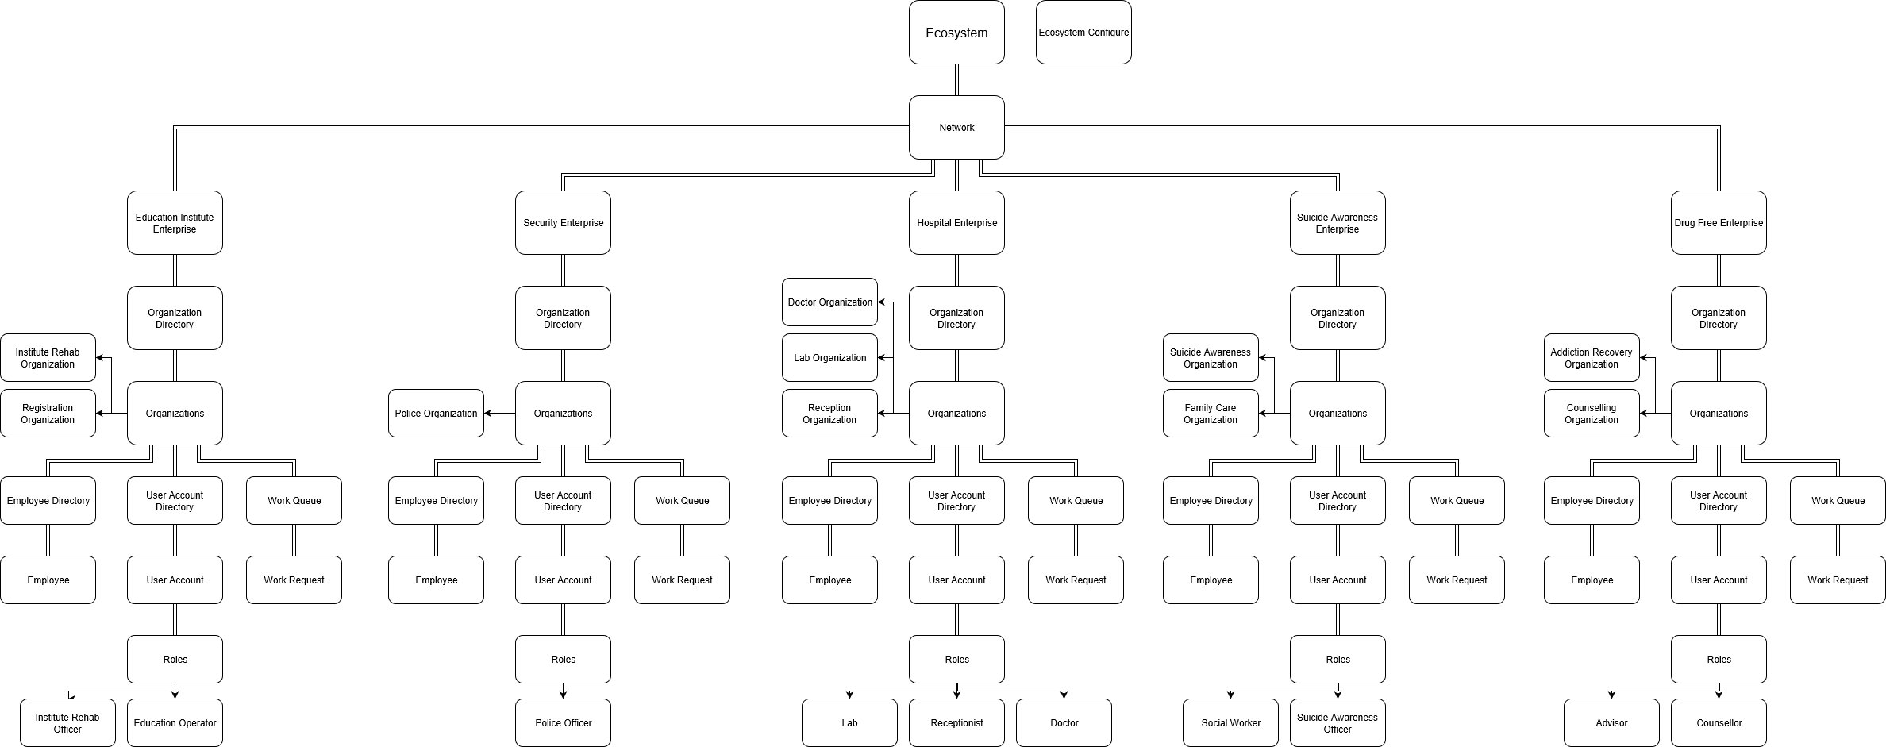
Object Model:

Slide 6
Suicide Prevention
Event – A person comes for a checkup to hospital
Suicide Evaluation – It consists of a threat index which is calculated based on five factors like environmental factors, vital signs, external factors , behavioral factors and health factors.
Each event will perform suicide evaluation for the associated person.
Alerts are sent to enterprise if event records threat index greater than previous event threat index.

Slide 7
Drug Abuse Prevention
Event : A person comes to a hospital for checkup.
He is registered and further sent to lab for checkup.
Vital Signs of that person are checked and sent to respective enterprises. Based on the priority, he will be re-directed to the respective organizations for further process.

Slide 8
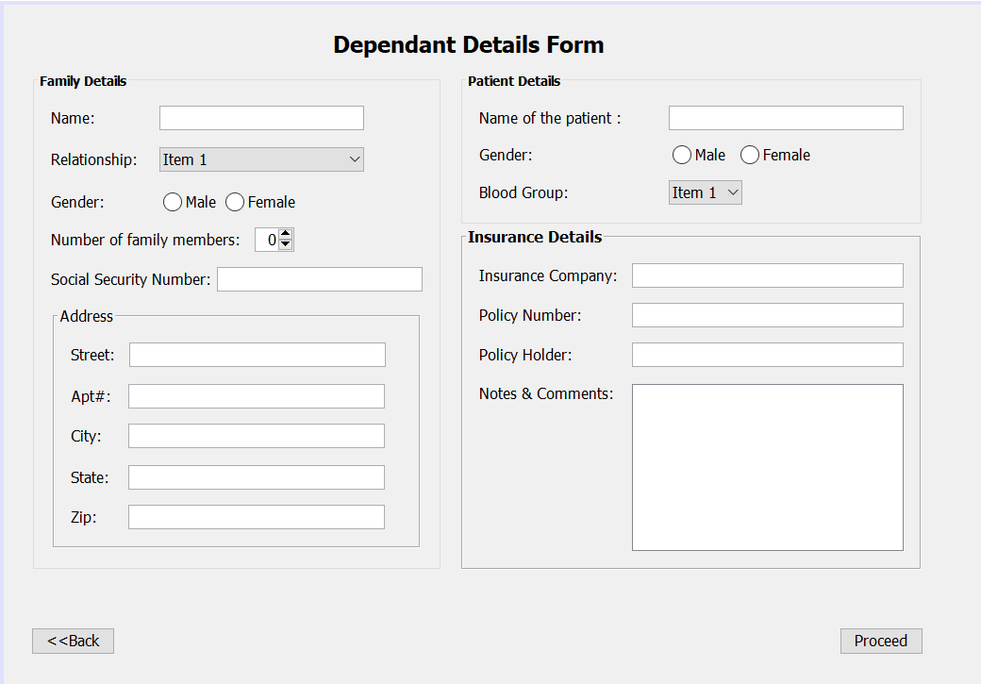
Screenshots:
The form depicts the information about the patient and his family, as well as other details in order to check for the mental & physical health of the patient.

Slide 9
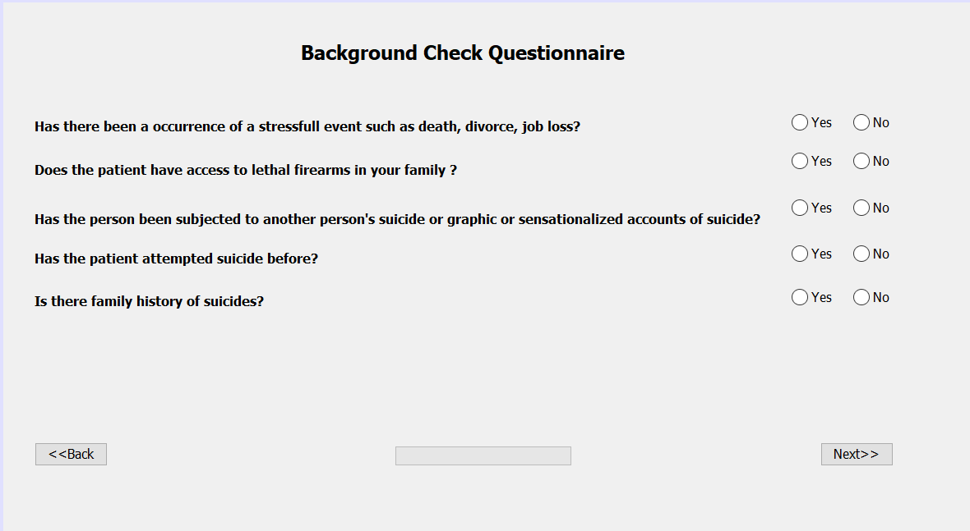
The Questionnaire:
The questionnaire will serve the purpose of getting in depth information about the patient and his past life which will play a vital part in determining the health of the patient.

Slide 10
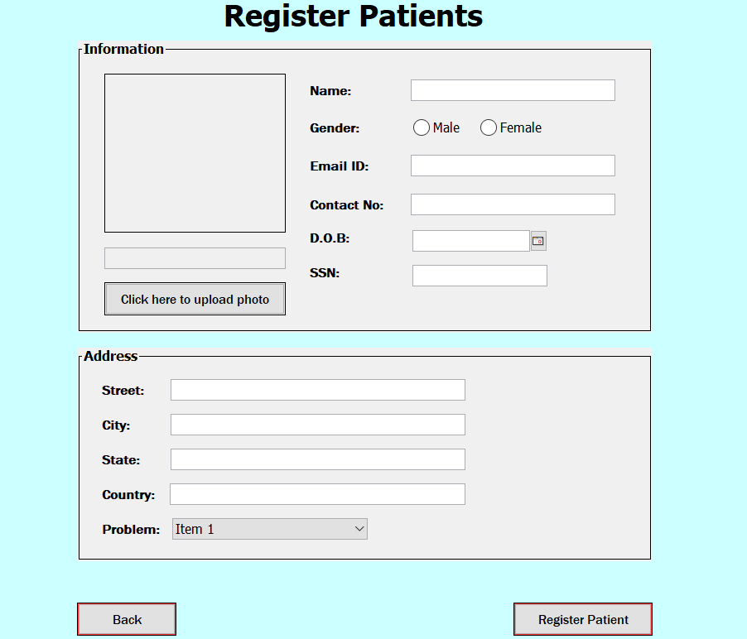
Patient Registration
The main registration screen where patients will register for an appointment. The vital signs will be checked and the patient will be traversed to the respective organization for further treatment.

